Slide 1





Introduction to Cab Booking System
Welcome to the world of convenient transportation! This presentation will guide you through the development of a user-friendly cab booking system, streamlining your transportation needs and offering a seamless experience for both users and drivers.
by Sai Santhosh

Slide 2
HTML Structure
The foundation of our cab booking system lies in a well-organized HTML structure. We will create a clear hierarchy using divs, headers, and paragraphs to separate the different components of the system.
User Interface
Booking Form
Driver Dashboard
The user interface will be designed to provide an intuitive and engaging experience for passengers.
This section will handle user input, allowing them to specify their pick-up location, destination, and other preferences.
The driver dashboard will allow drivers to track ride requests, manage their routes, and accept or decline bookings.

Slide 3

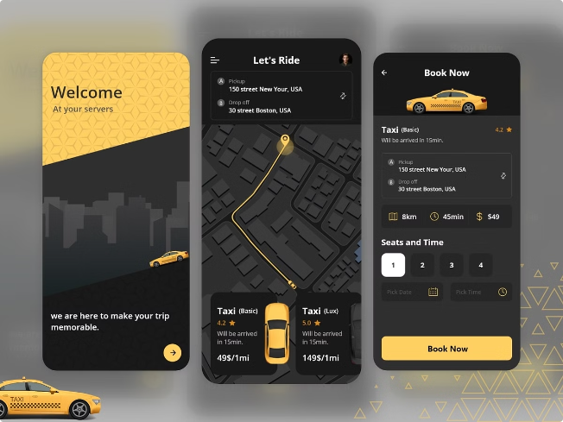
User Interface Design
The User Interface (UI) of the cab booking system is crucial to its success. A visually appealing and user-friendly design can enhance the overall experience for passengers.
Intuitive Navigation
Responsive Layout
The system should be easy to navigate, with clear labels and logical flow.
The design should adapt to different screen sizes, ensuring optimal viewing on mobile devices and desktops.
Visual Appeal
Accessibility Features
The UI should be visually engaging, incorporating a pleasing color scheme and clear typography.
The system should cater to users with disabilities, offering options for screen readers and alternative navigation methods.

Slide 4

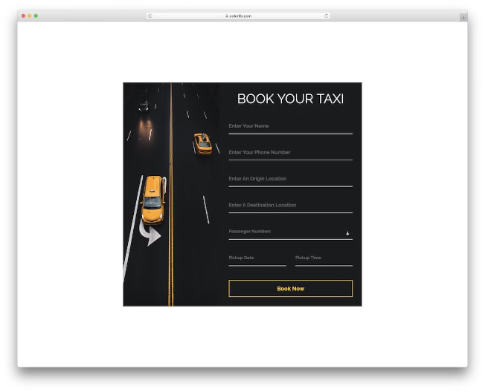
Booking Form
The booking form acts as the central point of interaction for passengers. It captures essential information needed to fulfill their ride requests.
1
Pick-up Location
2
Destination
Allows users to input their starting point, which can be done by typing an address, selecting from a list of landmarks, or using GPS coordinates.
Similar to pick-up location, users can input their desired destination.
3
Ride Preferences
4
Time and Date
Users can specify their preferences, such as vehicle type, car features, and payment methods.
Users can choose their desired pick-up time and date, whether it's for immediate pickup or a scheduled ride.

Slide 5

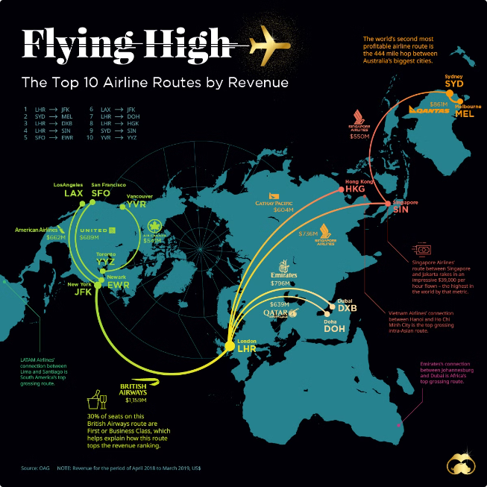
Fare Calculation
The system needs a robust fare calculation engine that takes into account various factors to determine the cost of each ride.
Distance
The base fare will increase proportionally to the distance traveled.
Time
Depending on traffic conditions and the duration of the trip, an additional time-based charge may be added.
Vehicle Type
Luxury cars or vehicles with specific features will have higher fares.
Surcharges
Additional fees may apply for peak hours, late-night trips, or specific destinations.

Slide 6

Confirmation and Payment
After the user submits their booking request, the system needs to process the information, confirm the ride, and handle payment securely.
Ride Confirmation
The system should send a confirmation message to the user, providing details of the ride, including the estimated time of arrival, driver information, and fare details.
Payment Processing
The payment gateway should securely process transactions and ensure that the driver receives the correct fare.
1
2
3
Payment Options
The system should offer a variety of secure payment options, including credit card, debit card, digital wallets, and cash on delivery.

Slide 7




Driver Allocation
The system should intelligently match available drivers to incoming ride requests, taking into account factors like driver location, vehicle type, and passenger preferences.
Request Matching
The system will identify drivers who are closest to the pick-up location and have the appropriate vehicle type.
Driver Notification
Drivers will receive notifications on their app, presenting them with the ride details, including pick-up and drop-off locations, passenger details, and estimated fare.
Driver Acceptance
Drivers have the option to accept or decline the ride request based on their availability and preference.

Slide 8

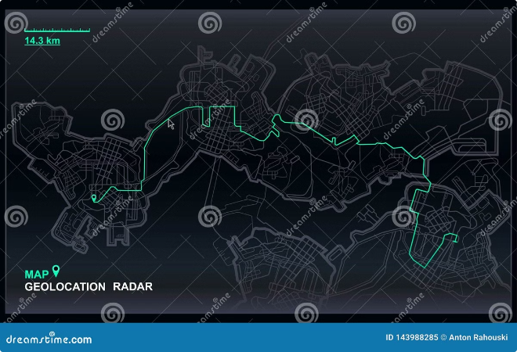




Conclusion and Future Enhancements
The cab booking system provides a convenient and efficient way for passengers to book rides and for drivers to earn income. However, there is always room for improvement.
Advanced Routing
Integrated Payments
Integrating real-time traffic data can optimize routes and provide more accurate arrival times.
Adding options like in-app payments can make the booking process more streamlined.
Driver and Passenger Ratings
Vehicle Tracking
Implementing a rating system can enhance trust and accountability for both parties.
Real-time vehicle tracking can improve safety and provide peace of mind for passengers.

